Slide 1
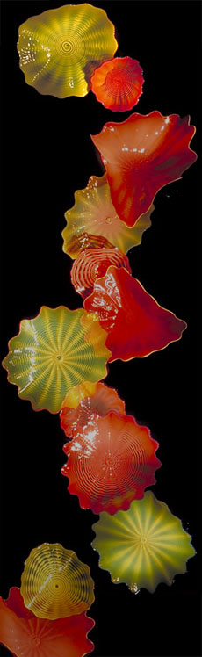
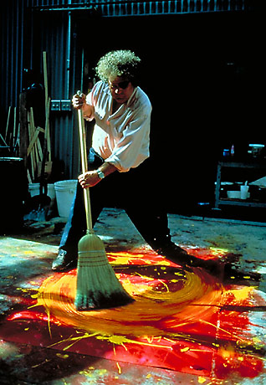

Dale Chihuly:
The Master of Glass
Presented by: Cheryl DeBerg
Notes:
Chihuly revolutionized the art of blowing glass, through the use of color and in the size of the vessels he has created. But it is through his own unique interpretation and perspective that the magic of his imagination is demonstrated through his grand scale installations.

Slide 2
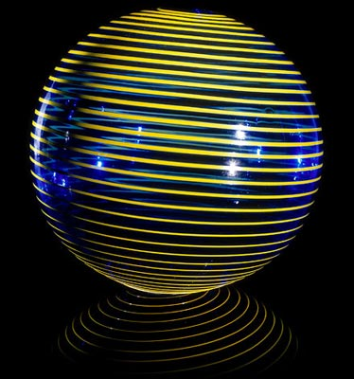
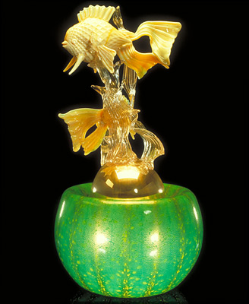
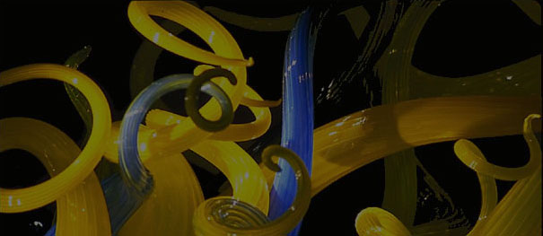
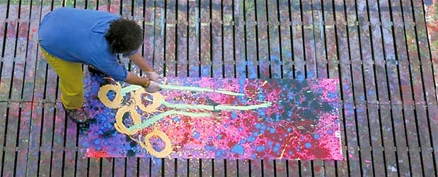
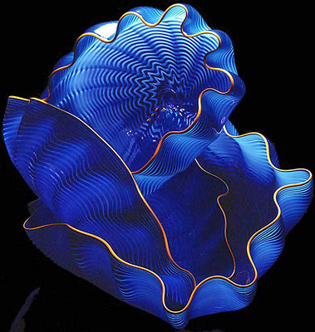
Born in 1941 in Tacoma, Washington, Dale Chihuly was introduced to glass while studying interior design at the University of Washington. Later he enrolled in the first glass program in the country at the University of Wisconsin. In 1968, Chihuly was awarded a Fulbright Fellowship to work at the Venini factory in Venice, Italy. While in Venice, Chihuly observed the team approach to blowing glass, which is critical in the way he works to this day.
Notes:
Chihuly choreographs his crew of around 90 people - from glass-blowers to installation experts. They start with his drawings or paintings, and end with surreal, fluidic sculptures. Chihuly compares himself to a conductor or film director.

Slide 3
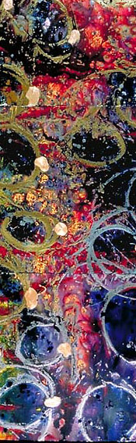
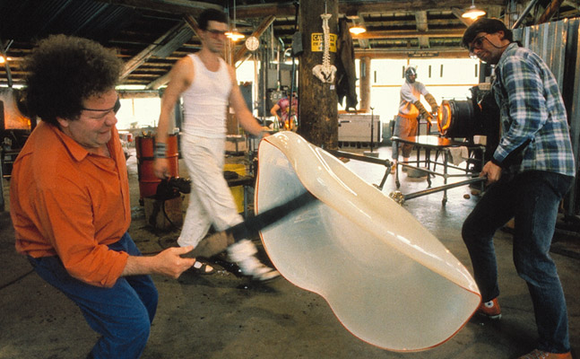
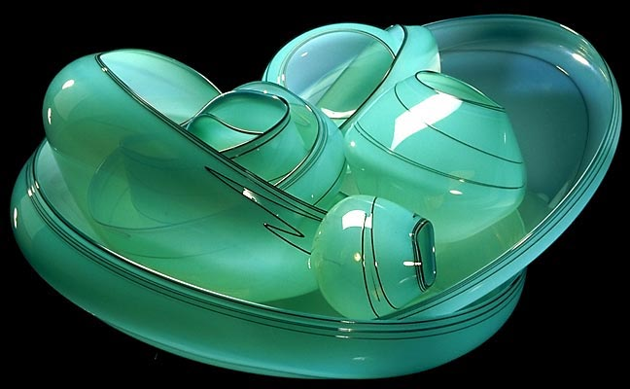
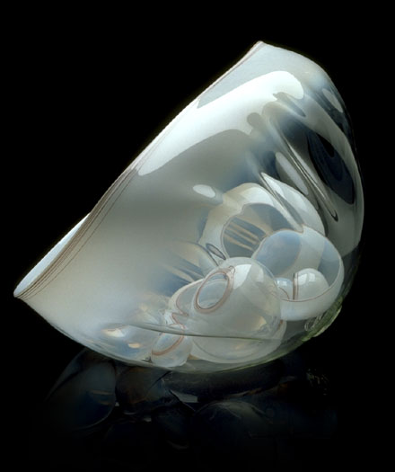
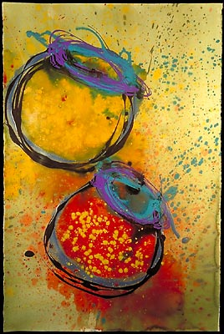
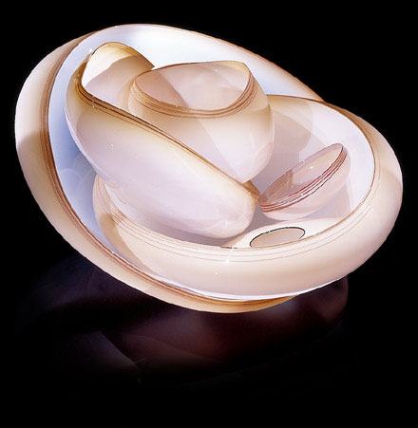
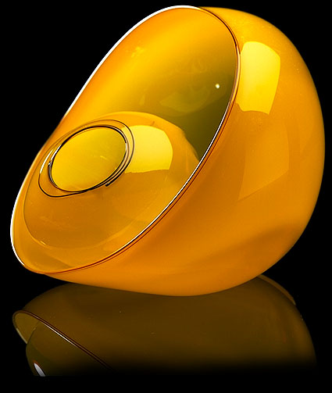
BASKETS
Notes:
The Basket series developed out of the woven Northwest Coast Indian baskets that Chihuly saw in 1977 with his late friend the sculptor Italo Scanga and sculptor James Carpenter at the Tacoma Historical Society.

Slide 4
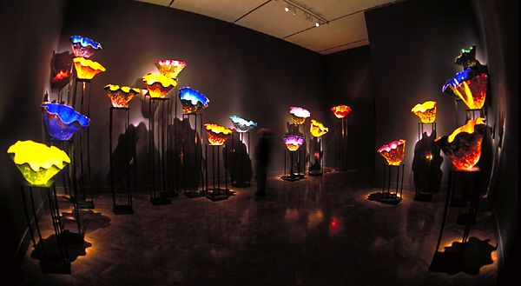
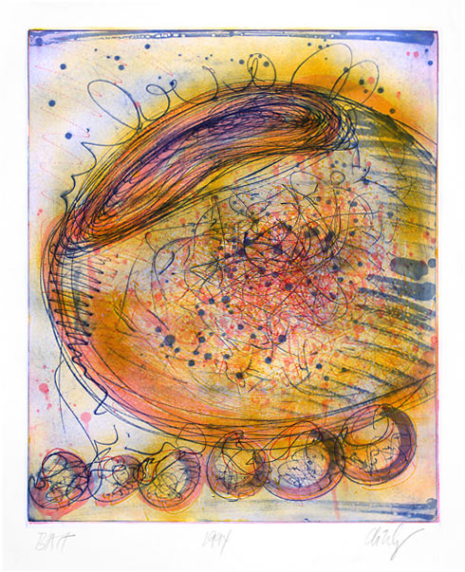
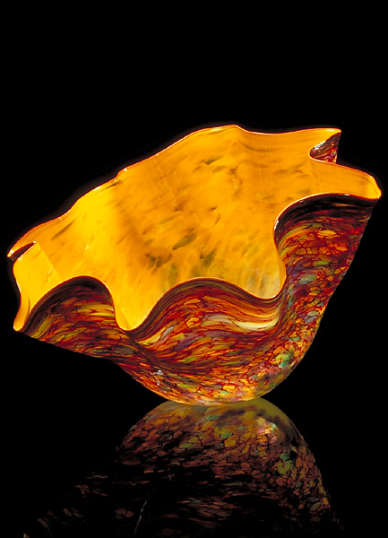
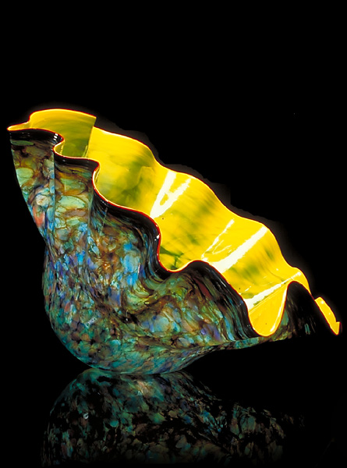
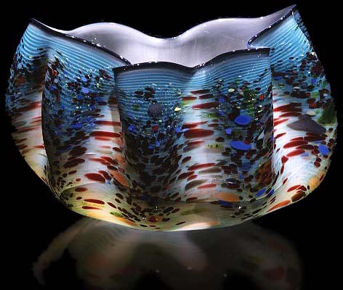
MACCHIAS
“The Macchia series began with my waking up one day wanting to use all 300 of the colors in the hotshop. . Like much of my work, the series inspired itself. The unbelievable combinations of color—that was the driving force.” (Chihuly)
MACCHIAS
Notes:
In 1971, Chihuly co-founded Pilchuck Glass School in Washington State. With this international glass center, Chihuly has led the avant-garde in the development of glass as a fine art. His works are included in more than 200 museum collections worldwide. He has been the recipient of many awards, including ten honorary doctorates and two fellowships from the National Endowment for the Arts.

Slide 5
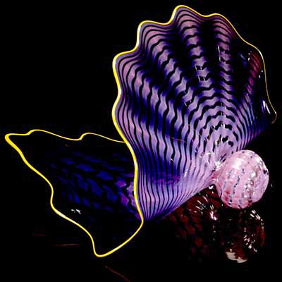
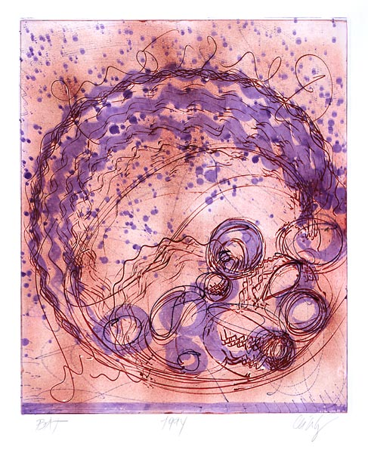
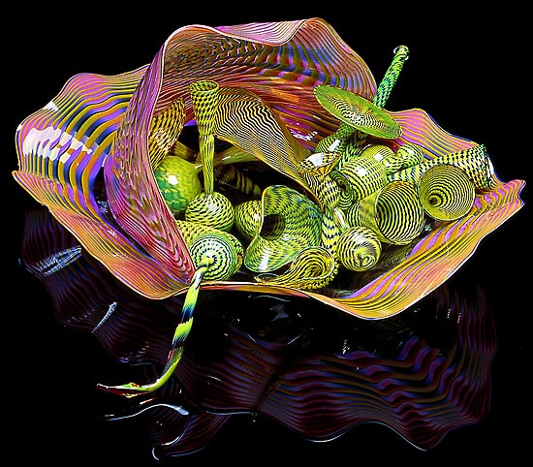
PERSIANS
Notes:
The Persians started out as a search for new forms. Chihuly would make several dozen small and large form pencil drawings, and then I would put an X under the ones I wanted the gaffers to go for. Over the next year, they made more than 1,000 miniature experimental forms.

Slide 6
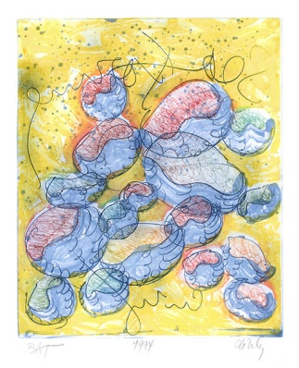
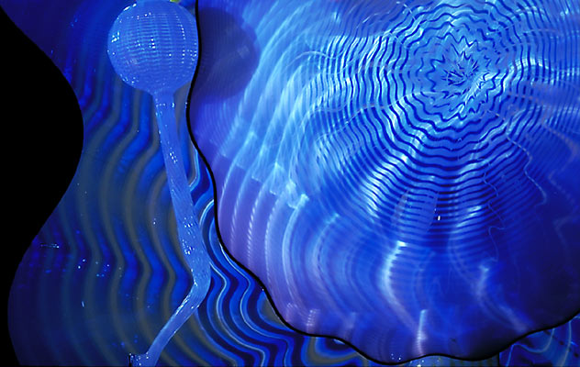
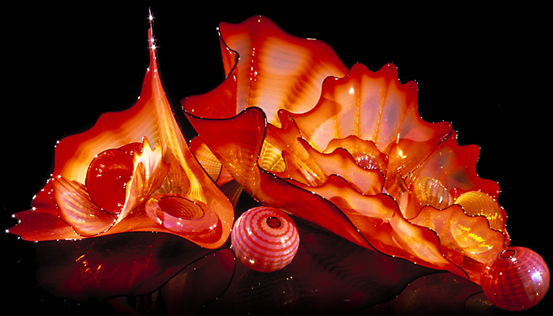
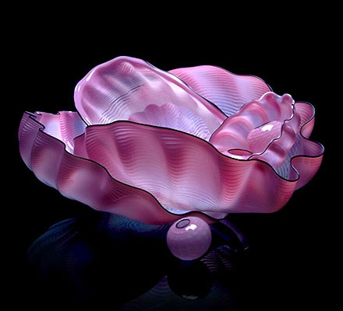
SEA FORMS
“I love to walk along the beach and go to the ocean. And glass itself, of course, is so much like water. If you let it go on its own, it almost ends up looking like something that came from the sea.” (Chihuly)
Notes:
The Seaforms were blown in optic molds, resulting in surfaces decorated with repeating ribbed motifs. Chihuly’s connection to nature is obvious in his work. The dazzling, organic-looking sculptures seem to have a life of their own. In fact, they pulse.

Slide 7
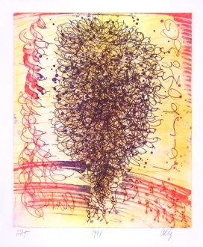
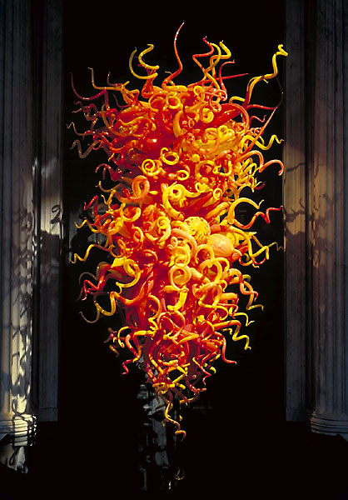
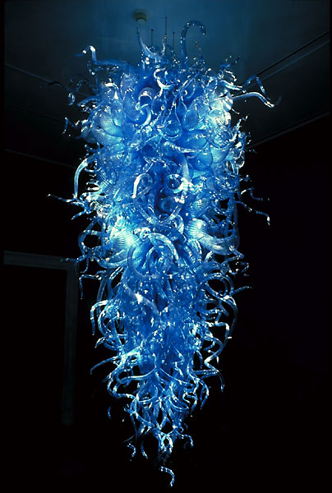
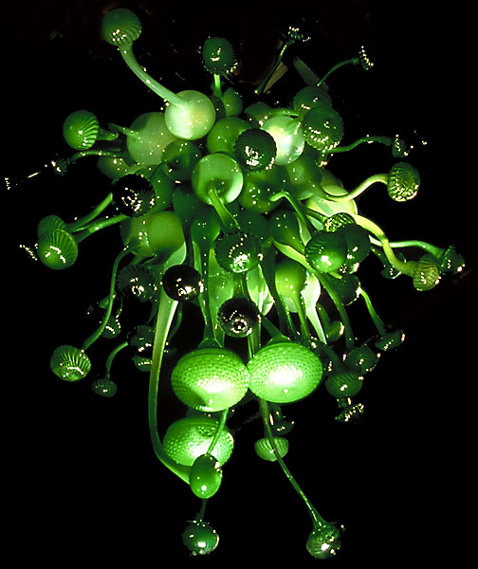
CHANDELIERS
Notes:
The elongated, linear blown forms, that are a product of the glassblowing process, became significant parts of Chihuly’s vocabulary. These highly baroque, sometimes writhing elements are especially effective in the Chandeliers.

Slide 8
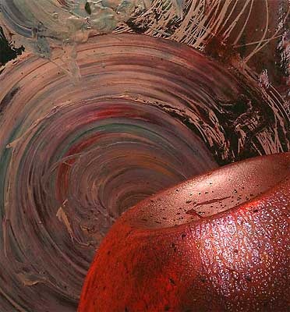
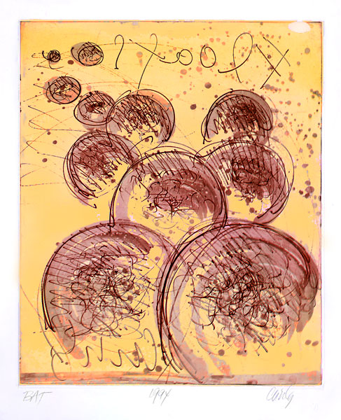
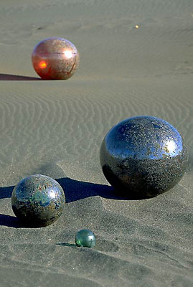
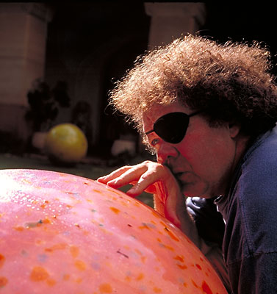
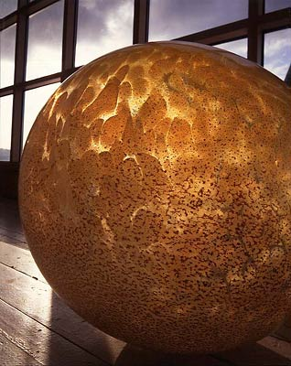
FLOATS
Notes:
The floats are probably the most monumental looking shape that Chihuly has ever made, since there is no reminiscence of a container shape. Because of their large size, the Floats are technically and physically the most difficult things that he has ever done. Even though a sphere or a ball is about the easiest form you can make in glass, when you get to this scale, up to forty inches in diameter, it becomes extremely difficult.

Slide 9
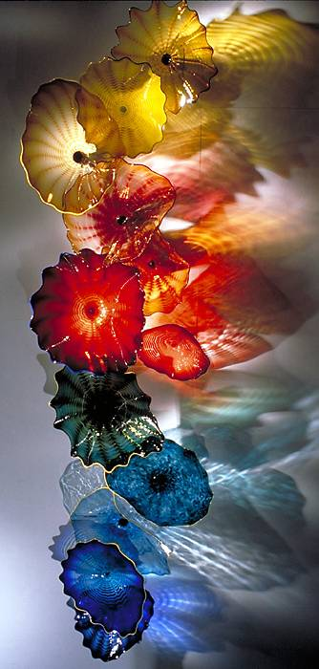
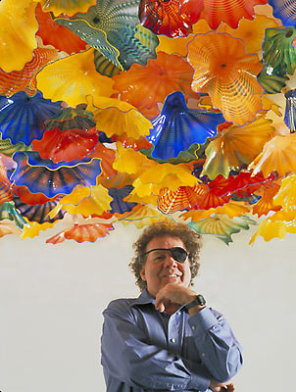
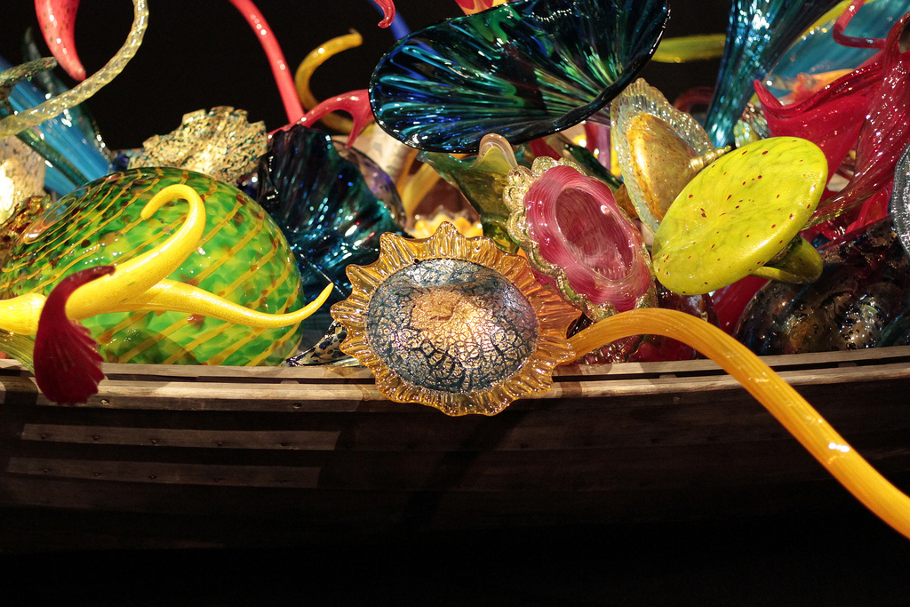
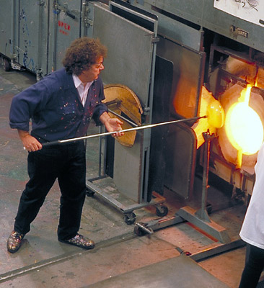
WALL
EXHIBITIONS
Chihuly’s artwork is not only vibrant and full of color, it is also dynamic and ever changing. In many cases it is designed specifically for the space it will be exhibited in. His exhibits and the artwork itself are a result of teamwork collaboration.
Notes:
Chihuly’s practice of putting together teams of artists with exceptional glassblowing skills has led to the development of complex, multipart sculptures of dramatic beauty and scale that place him in the leadership role of moving blown glass out of the confines of the small, precious object and into the realm of large-scale sculpture and environmental art. In fact, Chihuly deserves much of the credit for establishing the blown glass form as an accepted medium for installation art and, for contemporary expression in late twentieth and twenty-first century art in general.

Slide 10
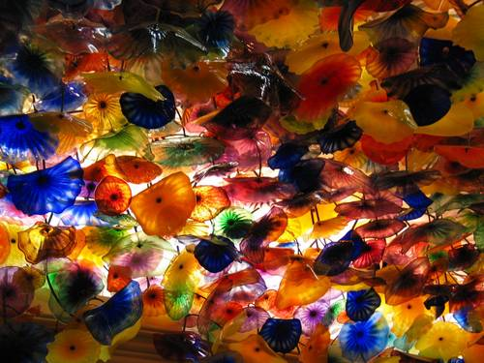
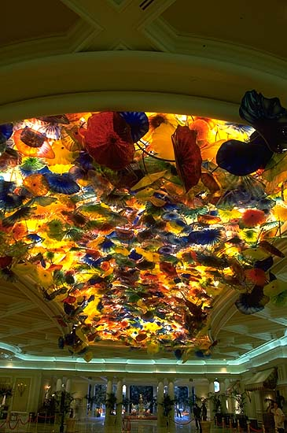
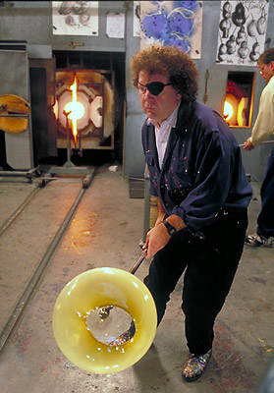
This magnificent glass sculpture is called “Fiori di Como” and is located at the Bellagio Hotel in Las Vegas, Nevada. Completed in two years, it is composed of over 2,000 individually blown glass pieces and covers approximately 2,000 square feet of ceiling, creating a veil of glass flowers. The glass pieces are attached to the ceiling using a matrix of steel rods, which extend into space like the branches of trees. The “Fiori di Como” brought a new vocabulary of form to Chihuly’s work, and a transcendent experience of beauty to the viewers.
For further information please visit Dale Chihuly’s web site: www.chihuly.com.
Thank you for your time!
Notes:
Dale Chihuly and team built the entire seventy-by-thirty-foot ceiling in Seattle. The work, "Fiori di Como, was installed with over two thousand handblown glass elements in the Bellagio Hotel in Las Vegas. The work radiates light from sun and is a "must visit" when you are in Las Vegas.

